Slide 1


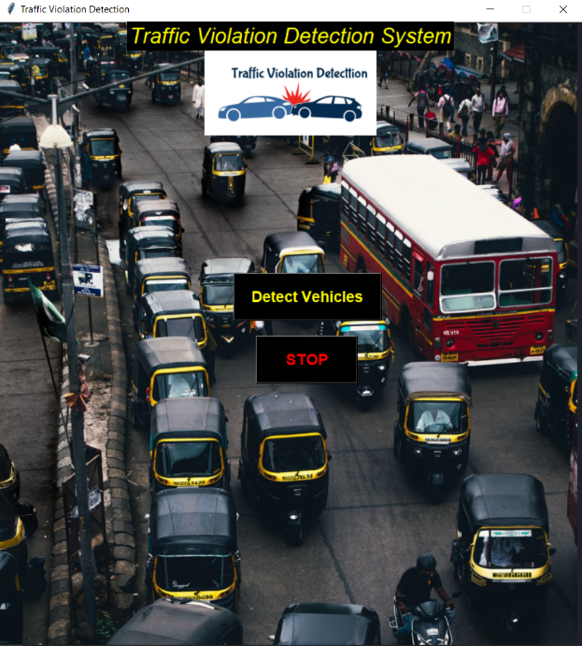





TRAFFIC VIOLATION DTECTION USING AI
Presented by
Aniket Belokar
DEPARTMENT OF COMPUTER TECHNOLOGY
May-2021
1

Slide 2

Content
Abstract
Introduction
Theory and fundamentals
Objectives
Literature review
Methodology
Tools and technologies
Testing / Experimentation
Data collection / Data analysis Findings and results
Applications
Conclusion
Future scope
References
2

Slide 3
1. Abstract
Analysing the statistics of road traffic violations in India, it can be concluded that the creation of automatic detection systems for traffic violations For crosswalks peoples or two wheeler bikes is necessary to improve safety on the roads of the country.
Therefore, the development of a system for fixing traffic violations is urgent and will be in demand. The literature here is mainly focused on vehicle detection, Traffic violation detection systems are effective tools to help traffic administration to monitor the traffic condition.
It can Detect and track the vehicle and their activities accurately is the main priority of the system. It can detect traffic violations, such as running red lights, speeding, and vehicle retrogress in real time.
In this paper, we propose an improved background-updating algorithm by using wavelet transform on dynamic background, and then track moving vehicles by feature-based tracking method. A complete traffic violation detection system is realized in Python YOLO, OpenCV.

Slide 4
2. Introduction
The increasing number of cars in cities can cause high volume of traffic, and implies that traffic
violations become more critical nowadays in India and also around the world.
This causes severe destruction of property and more accidents that may endanger the lives of the people. To solve the alarming problem and prevent such unfathomable consequences, traffic violation detection systems are needed.
A user friendly graphical interface is associated with the system to make it simple for the user to operate the system, monitor traffic and take action against the violations of traffic rules.
For which the system enforces proper traffic regulations at all times, and apprehend those who does not comply.
A traffic violation detection system must be realized in real-time as the authorities track the roads all the time. Traffic detection system detects violations faster than humans.
This system can detect traffic light violation in real-time.
A user friendly graphical interface is associated with the system to make it simple for the user to operate the system.
Monitor traffic and take action against the violations of traffic rules.
2

Slide 5

3. Theory and fundamentals
Detecting and tracking the vehicle and their activities accurately is the main priority of the system. It is Real-time traffic violation detection
Vehicle Classification
In this moving objects are detected.
YOLOv3, open CV is used to classify those moving objects into respective classes & detection of object.
Traffic Measurement
In this project it can measures the number of vehicles.
Measure the up and down goes vehicles.

Slide 6
3. Theory and fundamentals
Violation Detection
After detecting the vehicles, violation cases are checked.
A traffic line is drawn over the road in the preview of the given video footage by the user.
The detected objects have a green bounding box
After detecting violation, the bounding box around the vehicle becomes red.
Decision Making
This computer vision based system is faster than human work & observation.
gives violation output within time.(real time)

Slide 7

4. Objectives
The goal of the project is to automate the traffic signal violation detection system.
Make it easy for the traffic police department to monitor the traffic and take action against the violated vehicle owner in a fast and efficient way.
Detecting and tracking the vehicle and their activities accurately is the main priority of the system.
Make Road traffic police free from such struggling duty, remove all human work beside and provide such accurate violation detection system.
2

Slide 8

5. Literature review
Sr. No. | Author | Title | Source | Findings/Remark
1 | Name (year) | Title of research articles / book | Journal /Publication | Your findings and remarks about this work
2 | Ms. C. Sushmitha, J. Subhasree, Thushara. S.S (2020) | Traffic Rules Violation Detection System | International Research Journal of Engineering and Technology (IRJET) | System overview
3 | Dr. Rekha P M, Likitha G, Nishant Kumar, Alisha Simran(2020) | Study of Different Approaches to Develop an Automatic Traffic Rule Violation Detection System | International Research Journal of Engineering and Technology (IRJET) | System workflow
4 | Ahmet Sayar, Seda kul | Distributed and collaborative real-time vehicle detection and classification over the video streams | International Journal of Advanced Robotic Systems | Tracking, security lane, and wrong way violation detection.

Slide 9
6. Methodology
Presented in is the implementation of real-time traffic violation detection in a monitoring stream which utilized simultaneous video stream from different cameras using parallel computing techniques.
Vehicle Classification
From the given video footage, moving objects are detected. An object detection model YOLOv3, open CV is used to classify those moving objects into respective classes. YOLOv3 is the third object detection algorithm in YOLO (You Only Look Once) family. It improved the accuracy with many tricks and is more capable of detecting objects. The classifier model is built with Darknet-53 architecture.
Violation Detection
The vehicles are detected using Open CV, YOLOv3 model. After detecting the vehicles, violation cases are checked. A traffic line is drawn over the road in the preview of the given video footage by the user.

Slide 10
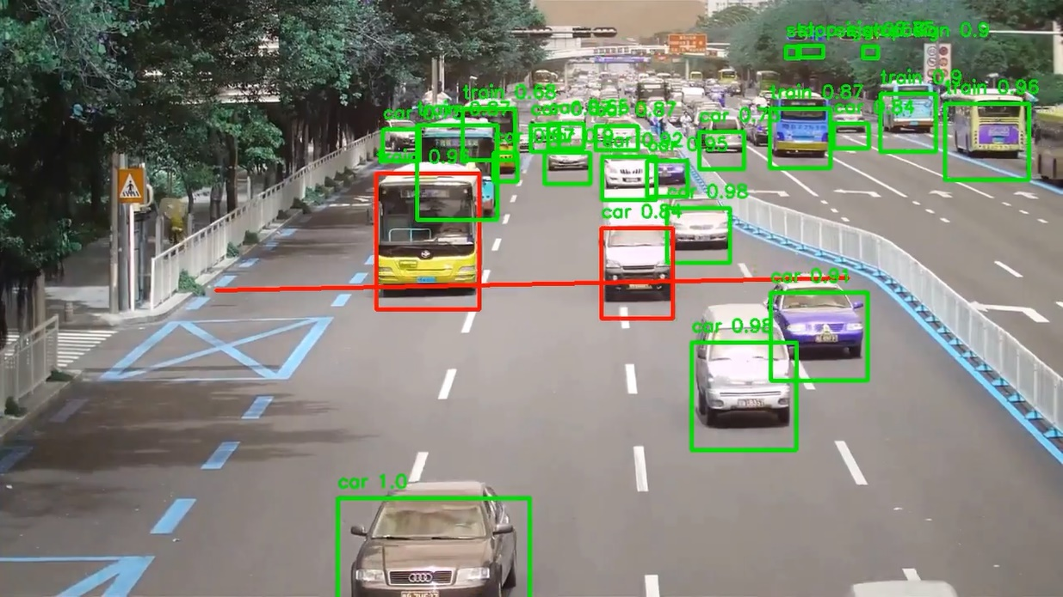
6. Methodology
Violation happens if any vehicle like car crosses the trucks, dumpers traffic line on highway road. The detected objects have a green bounding box. If any vehicle like car passes the truck line light in red state, violation happens. After detecting violation, the bounding box around the vehicle becomes red.
GUI
The Graphical User Interface (GUI) makes the system interactive for the user to use. User can monitor the traffic footage and get the alert of violation with the detected bounding box of vehicle. User can take further action using the GUI.

Slide 11
7. Tools and technologies
Computer Vision
OpenCV
Opencv is an open source computer vision and machine learning software library which is used in this project for image processing purpose.
Yolo
YOLOv3 (You Only Look Once, Version 3) is a real-time object detection algorithm that identifies specific objects in videos, live feeds, or images. The vehicles are detected using YOLOv3 model.
Tkinter
Tkinter is Python's de-facto standard GUI (Graphical User Interface) package.

Slide 12

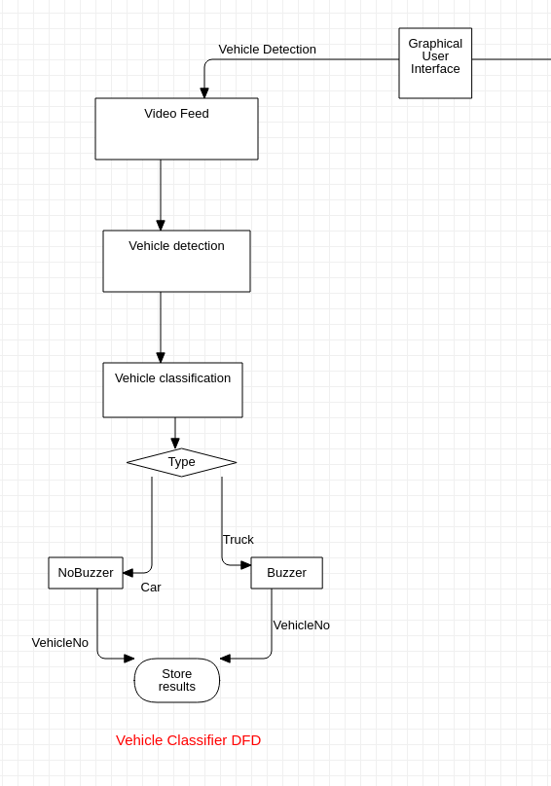
8. Testing / Experimentation
Primarily, for the start of the project usage, the administrator needs to open a video footage using ‘Open’ item that can be found under ‘File’.
After opening a video footage from storage, the system will get a preview of the footage, it contains a frame from the given video footage. The preview is used to identify roads and draw a traffic line over the road. we need to select ‘Region of interest’ item from the ‘Analyze’ option. After that administrator will need to select two points to draw a line that specifies traffic signal.
Selecting the region of interest will start violation detection system. The violation detection system will start immediately after the line is drawn. Then the system will detect objects and check for violations. The output will be shown frame by frame from the GUI.
The system will show output until the last frame of the footage. In background a ‘output.mp4’ will be generated.
12

Slide 13

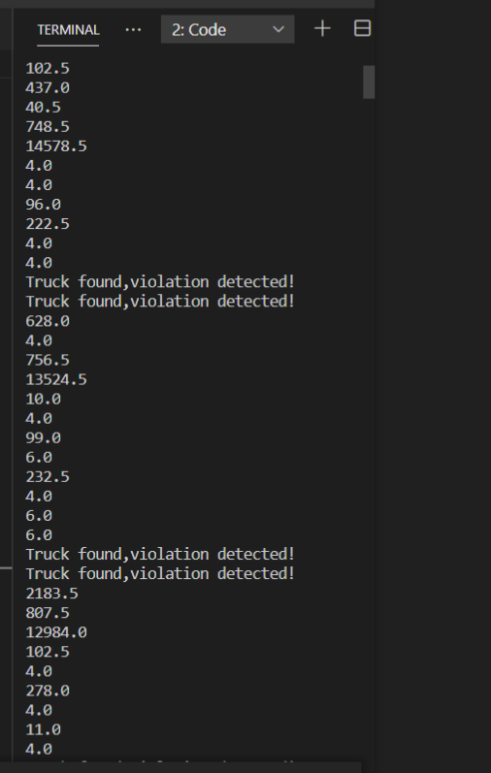
9. Data collection / Data analysis
Violation traffic data is collected from the software.
The system will detect objects and check for violations. The output will be shown frame by frame from the GUI
13

Slide 14

10. Findings and results
Hence, by using computer vision technology
we find a traffic violation detection from given video.
we find vehicle classification.
If the truck came in car lane then system will immediately detects violation, and gives fast decision output.
14

Slide 15

11. Applications
This system can be implemented in 4-way ,6-way highways, where violation is quite difficult for road traffic police.
It can be implemented in crowd traffic areas for restriction of truck ,where trucks are not allowed in absence of police.
This system is also used for measuring the numbers of vehicle on entry gate.
15

Slide 16
12. Conclusion
The designed algorithm was effectively able to detect the type of violation specified on this project which are denying traffic signal.
The system provides detection for traffic signal violation. Further, the system is able to process one data at a time.
Also, the program runtime is somewhat slow, and can be improved by using a computer with high speed processor specifications or GPU.
Future research about the application of the designed algorithm for other advanced image processing techniques.
A computer vision algorithm may be done instead to provide more intelligence in the system.
16

Slide 17
13. Future scope
Adding more real life features.
Making this system robotic Adding Number Plate Detection with OCR support Adding more traffic violation conditions.
Also make this system to detect helpmates.
If a vehicle stands still in no parking zone for a predefined time, so make this to detected as a parking violation.
17

Slide 18
14. References
[1] G. Ou, Y. Gao and Y. Liu, "Real Time Vehicular Traffic Violation Detection in Traffic Monitoring System," in 2012 IEEE/WIC/ACM, Beijing, China , 2012.
[2] X. Wang, L.-M. Meng, B. Zhang, J. Lu and K.-L.Du, "A Video-based Traffic Violation Detection System," in MEC, Shenyang, China, 2013.
[3] Joseph Redmon and Ali Farhadi, "YOLOv3: An Incremental Improvement".
[4] M. Fathy & M.Y. Siyal, An image detection technique based on morphological edge detection and background differencing for real-time traffic analysis. Pattern Recognition Letters, 1995, Vol. 16, 1321-1330.
[5] B.K.P. Horn & B.G. Schunck, Determining optical flow. Artificial Intelligence, 1981, Vol. 17, 185-203.
[6] T. Poggio & W. Reichardt. Visual control orientation behavior in the fly: Part 2. Towards underlying neural interactions. Quarterly Reviews in Biophysics, 1976, Vol. 9, 377-438.
18

Slide 19
17

